Slide 1
HARDWARE EXERCISES

Slide 2
Instructions
Install the Arduino IDE (https://www.arduino.cc/)
Arduino languages is a set of C/C++ functions. Sketches are preprocessed and compiled to a C/C++ compilers (Arduino.cc.en/Hacking/BuildProcess)
To program the Arduino write a “sketch.”
At a minimum as sketch has “void setup()” method and a “void loop()”
No main() is required because your sketch is called like a function or method.
Familiarize yourself with the Arduino specific elements (Quick Reference)
As necessary review the Arduino code and built in examples
https://www.Arduino.cc/en/Reference/HomePage

Slide 3
Getting Started
Write a program to turn on a light with a button. (Examples=>Digital=>“Button”)
Turn on lights according to an array. EX: [R,B,G,R] turns on the red light, then the blue light, then the green light, and then the red.
Optional: Take user input
Use the lights to display decimal values as binary.
Optional: Allow the user to “count” by pressing the button.
Make a traffic light.
Optional: Allow the user to “change” a red or green light with a button.
Make an 8 digit “die” using 3 lights. Roll with using a button.

Slide 4
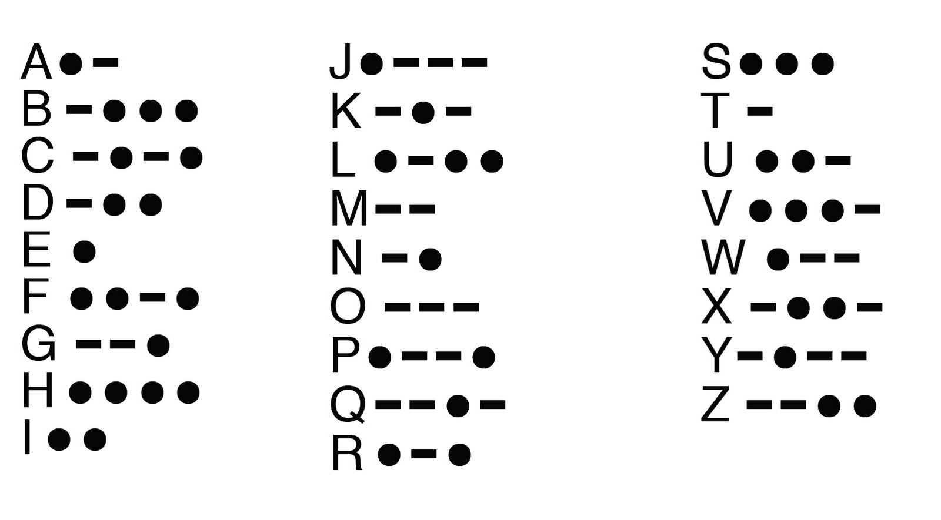
Morse Code
Write program that uses lights to blink a greeting in morse code
For instance have your lights blink “SOS”
Trying using one light for dot and a different for dash
Modify your program in one of the following ways:
Display a different message based on input from a button(s)
Display a different message based on reading input (a stream or file)
Implement both options from step 2.

Slide 5
Projects
Morse Code Logger: Create a program that takes morse code button input and writes the messages to a file and the output stream.
Trivia Game: Display questions from a file. The user answers using the buttons.
Use lights to display either: Correct/incorrect or lives remaining.

Slide 6
Projects
Mastermind: Your program has a random 3 digit code. (Each digit 0-8)
Use 3 lights to represent a digit to submit. Cycle through and submit the digits with the buttons
After submission, provide feedback with the lights.
Green=All three digits are correct, yellow = 1+ digits are in the right spot,
red = 1+ digits are out of order, no lights = none of the guessed digits are used
Ex: If the code is 811
Guess | Lights Lit
000 | None
100 | RED (There is a 1 but in a different spot)
001 | YELLOW (The 1 is in the correct spot)
811 | GREEN (This is the secret code)

Slide 7
Server
Create a server that broadcasts a set greeting
- For example: Broadcast “Hello world” on port 80 every 20 second.
Modify your server broadcast lines from a text file and broadcasts them on a specified port.
- For example: Have a text file where each line is a stock price. Every 10 seconds broadcast a new line.
Modify your server to listen on a set port. Have it send a different message based on the client’s message.
For example: If the client sends “Knock Knock” respond “who’s there” but if the client sends “Hello” respond “Hi”

